Slide 1

“Online Voting System Using Blockchain”
TERNA ENGINEERING COLLEGE
DEPARTMENT OF COPUTER ENGINEERING
BE/SEM-VIII
C-23 Atharva Birje
C-28 Harsh Minde
C-61 Ameya Mane
Under the guidance of
Prof. Dnyaneshwar Thombare
Academic Year
2024-25

Slide 2
CONTENT
Introduction
Abstract
Motivation
Literature review
Problem Statement & Objective
Scope of Project
Proposed System/ Architecture Diagram
User Interface
H/W and S/W requirements
Expected Outcome
Conclusion
References

Slide 3
INTRODUCTION
This project focuses on using blockchain technology to improve the security and transparency of voting systems. Existing methods face fraud and lack of trust, which blockchain's decentralized ledger can mitigate. The project creates a verifiable and secure voting system, advancing digital democracy.

Slide 4
ABSTRACT
This project develops a blockchain-based online voting system to enhance election security and transparency. By leveraging blockchain's immutable and decentralized features, the system prevents vote tampering and ensures real-time verification, addressing traditional voting challenges. The study aims to modernize and secure the electoral process through a reliable digital platform.

Slide 5
MOTIVATION
Traditional voting systems face challenges like fraud, tampering, inefficiency, and high operational costs, especially for large-scale elections.
Citizens living abroad often struggle to participate in elections due to geographic barriers, limiting their democratic rights.
This project enables secure online voting, allowing citizens to vote from anywhere in the world, ensuring their right to participate in elections is preserved.
By leveraging blockchain’s decentralized and transparent nature, this system ensures secure and accessible voting, enhancing trust in the electoral process.
The goal is to modernize the voting process, making it accessible, secure, and efficient for all, including overseas voters.

Slide 6
LITERATURE SURVEY
Sr. No. | Project Title | Author | Key Findings | Limitations
1. | Blockchain Enabled Online-Voting System | Akhil Shah, Nishita Sodhia, Shruti Saha, Soumi Banerjee, Madhuri Chavan​ 2020 | Utilizes blockchain to create an immutable and transparent voting system. Incorporates 128-bit AES encryption and SHA-256 for enhanced security. Authentication through unique identification keys and biometric fingerprint verification. Votes are cast and recorded as blockchain transactions, ensuring integrity and transparency. | The system currently uses Ethereum, a public blockchain, which may face scalability issues. The paper's model is designed for small organizations and may not be directly scalable to national-level elections. The use of fingerprint authentication alone may not be sufficient for comprehensive security, which we plan to enhance by integrating additional biometric measures such as facial recognition in our project.

Slide 7
Sr. No. | Project Title | Author | Key Findings | Limitations
2. | A Usable Android Application Implementing Distributed Cryptography for Election Authorities | Stephan Neumann, Oksana Kulyk, Melanie Volkamer 2014 | Developed an Android app for secure distributed key generation and verifiable vote decryption. Designed for non-technical election authorities to use easily without deep technical knowledge. Includes educational material, but users struggled with complex security concepts, highlighting the need for better educational tools. | Users' incomplete understanding of cryptography. Trust in external components like the web bulletin board poses risks. Usability testing was limited, requiring broader evaluation.

Slide 8
Sr. No. | Project Title | Author | Key Findings | Limitations
3. | E-Voting System in Smart Phone Using Mobile Application | G. Kalaiyarasi, T. Narmadha, K. Balaji, V. Naveen 2020 | Developed an Android-based e-voting system using AES256 encryption for secure vote storage and Firebase for OTP generation. The system allows voters to cast votes remotely, minimizing fraud and human errors in manual vote counting. Results are published instantly after the election ends. | No offline voting support, limiting access for users in remote areas. Reliance on OTP for authentication, vulnerable to mobile number or network issues. Potential security concerns with Firebase, as third-party servers may introduce vulnerabilities.

Slide 9
Sr. No. | Project Title | Author | Key Findings | Limitations
4. | A Scalable Implementation of Anonymous Voting over Ethereum Blockchain | Jae-Geun Song, Sung-Jun Moon, Ju-Wook Jang 2021 | The system allows for scalability in terms of both the number of voters and candidates, surpassing the limitations of previous blockchain voting systems. Time complexity is reduced. | The scalability of the solution, while improved, still faces challenges when applied to "big voting" scenarios, such as national elections. The system relies on a large prime number to accommodate scalability, which could potentially lead to performance issues .

Slide 10
Sr. No. | Project Title | Author | Key Findings | Limitations
5. | Survey on Blockchain-Based Data Storage Security for Android Mobile Applications | Hussam Saeed Musa, Moez Krichen, Adem Alpaslan Altun, Meryem Ammi | Blockchain enhances security and reliability of mobile app data storage. BSADS framework consists of six comprehensive layers. Identified challenges include scalability, performance, and cost. Proposed solutions include blockchain pruning and energy-efficient consensus algorithms. Emphasized importance of lightweight nodes for mobile apps. Highlighted research gaps in energy efficiency and usability. Blockchain offers advantages over traditional encryption methods. | Unsuccessful implementations in mobile voting projects. Scalability issues in Ethereum Name Service (ENS). DAO hack highlighting blockchain security vulnerabilities. Restricted throughput causing slower transaction times. High costs of data storage on blockchain. Privacy concerns due to blockchain transparency. Resource-intensive smart contracts affecting cost-effectiveness. Limited computational power impacting user experience. Different consensus algorithms affecting scalability and performance.

Slide 11
Sr. No. | Project Title | Author | Key Findings | Limitations
6. | Efficient E-voting Android Based System | Dr. Aree Ali Mohammed , Ramyar Abdolrahman Timour | Voting Methods: The system supports both SMS-based and internet-based voting, providing flexibility to voters . Authentication: Voters are authenticated through voter IDs, and GPS tracking helps identify the location of voters during the process. Security Features: Face recognition for admin access, as well as a MySQL database that prevents multiple voting from the same voter. Database Integration: Both SMS and internet voting methods are connected to the same MySQL database, ensuring consistency and preventing duplicate votes. | Security Concerns: The system admits that it is not as secure as traditional paper-ballot systems. Issues like electronic failures and system vulnerabilities in SMS voting are highlighted . Face Recognition Challenges: The face recognition system for admin access can fail under specific lighting or environmental conditions, limiting its reliability.

Slide 12
PROBLEM STATEMENT & OBJECTIVE
PROBLEM STATEMENT :
Traditional voting methods are vulnerable to errors, tampering, even cost high, and lack transparency, leading to inefficiencies and security concerns. The growing demand for trustworthy elections highlights the need for a secure, modern solution.
OBJECTIVE:
The objective is to enhance security, increase transparency, and ensure voter privacy while improving accessibility and guaranteeing immutability. Additionally, the project aims to reduce costs, enhance trust, and facilitate real-time results.

Slide 13
SCOPE OF THE PROJECT
This system will replace traditional voting methods with a decentralized approach, significantly enhancing the integrity and trustworthiness of the electoral process.
The project's scope encompasses the development of a robust mobile application seamlessly integrated with blockchain technology to ensure secure and transparent voting.
Additionally, the project includes integrating a secondary database to support data management and backup, ensuring reliability.
Focus will also be placed on implementing advanced security measures and optimizing performance to safeguard the system against potential threats.
Lastly, the project will address scalability to ensure the system can efficiently handle a large number of users and transactions, maintaining high performance during peak voting periods.

Slide 14
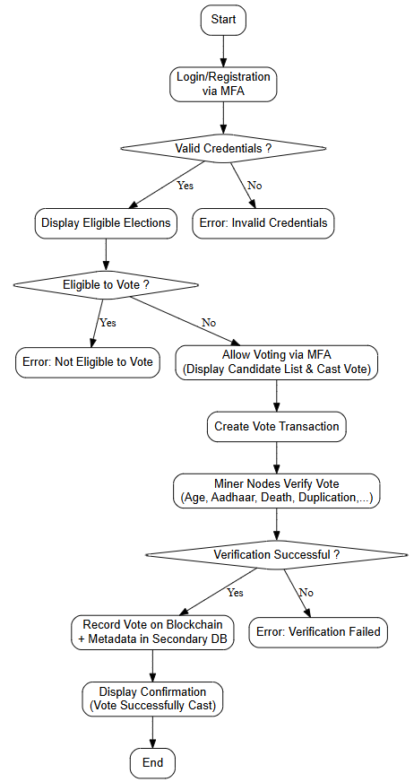
PROPOSED SYSTEM
Flow Chart :

Slide 15
Architecture Diagram (Overview):
SMART CONTRACTS
BLOCKCHAIN NETWORK
SECURITY & PRIVACY
USER INTERFACE (UI)
BACKEND SYSTEM
INTEGRATION & API GATEWAY
MONITORING & ANALYTICS
FIREBASE INTEGRATION

Slide 16
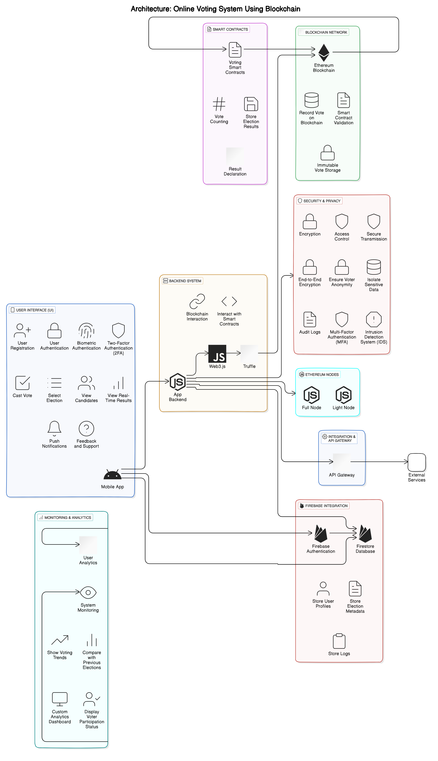


Architecture Diagram (Detail) :
Web3dart
Quick Node

Slide 17
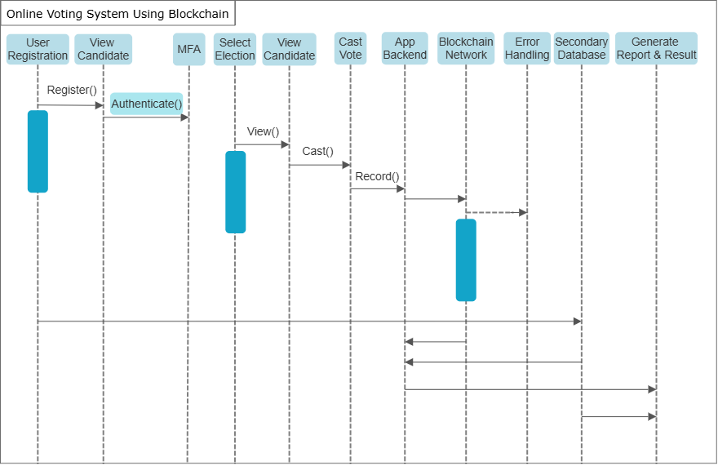
Sequence Diagram :-

Slide 18
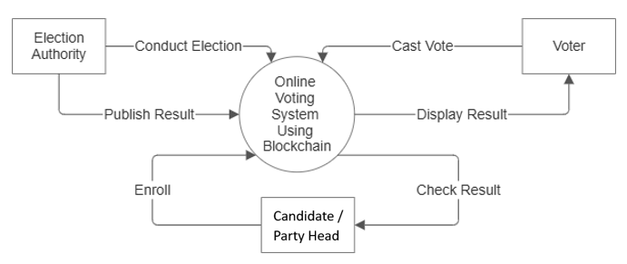
Data Flow Diagram (DFD Level 0) :-

Slide 19
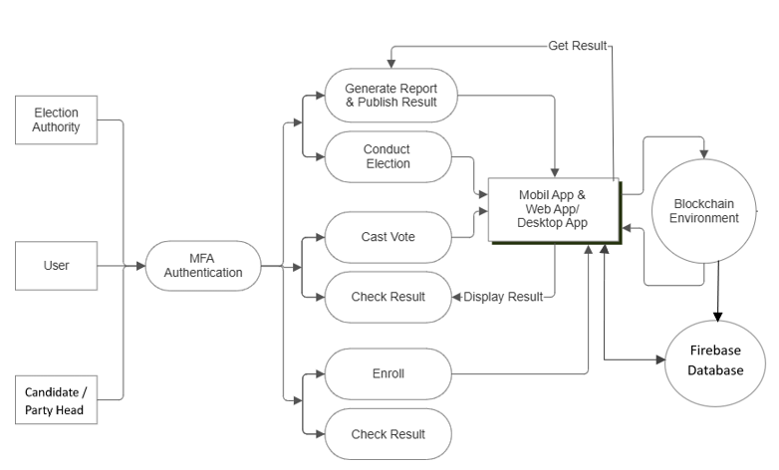
Data Flow Diagram (DFD Level 1) :-

Slide 20
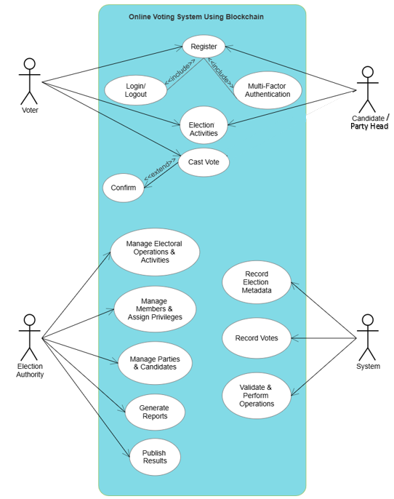
Use Case Diagram (UCD) :-

Slide 21
PROPOSED SYSTEM
Users register and log in using multifactor authentication, secured by biometric and OTP authentication.
After a successful login, they cast votes via a secure interface. Each vote is recorded on the Ethereum blockchain using Solidity smart contracts to ensure uniqueness and prevent duplication.
Non-sensitive data/metadata is stored in the Secondary database, while sensitive vote data is securely stored on the blockchain for transparency.
Real-time election results are fetched from the blockchain and displayed on a user-friendly interface developed in Android /Flutter.
The system ensures end-to-end encryption and voter anonymity is designed to handle large user loads during peak voting times.

Slide 22
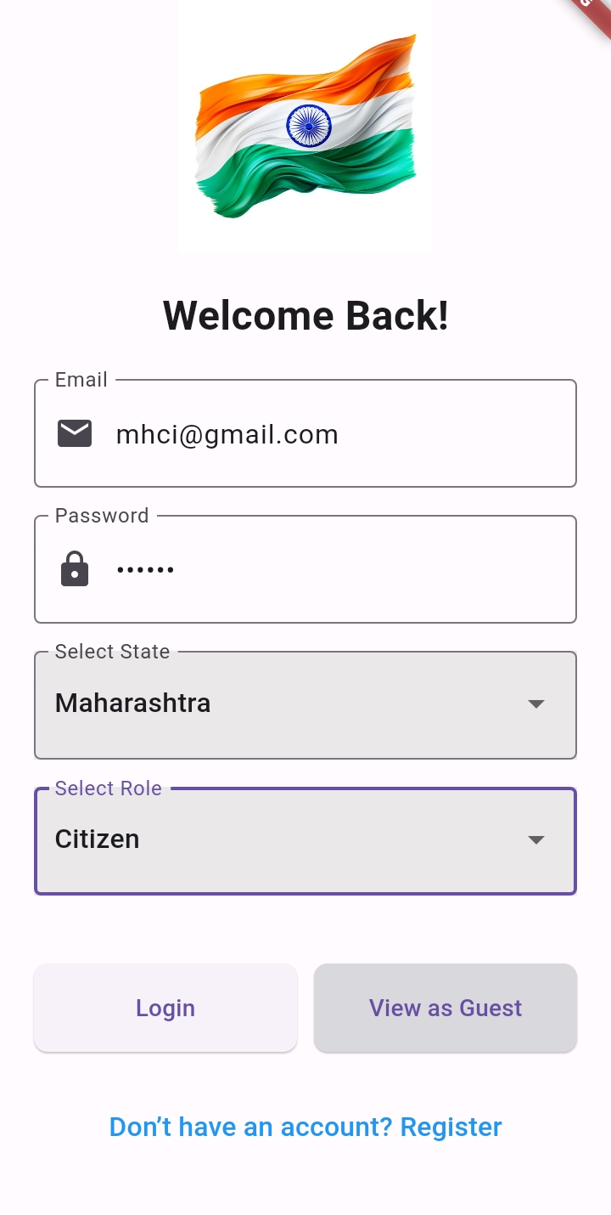
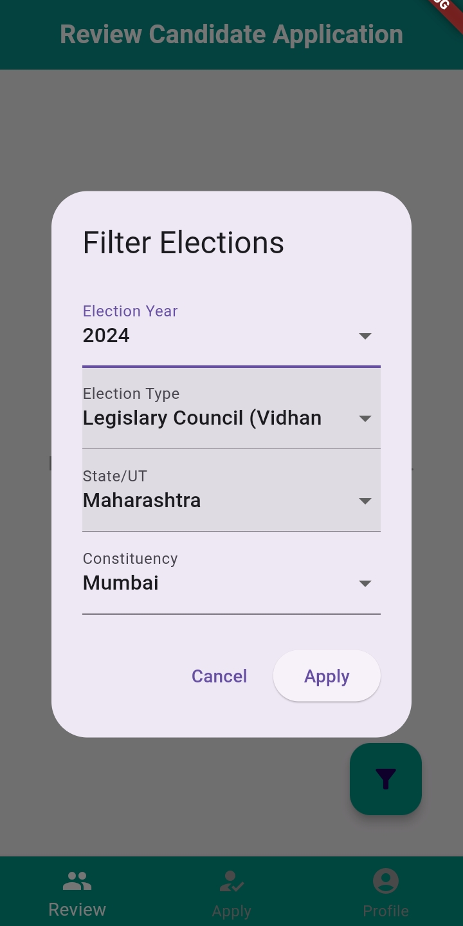
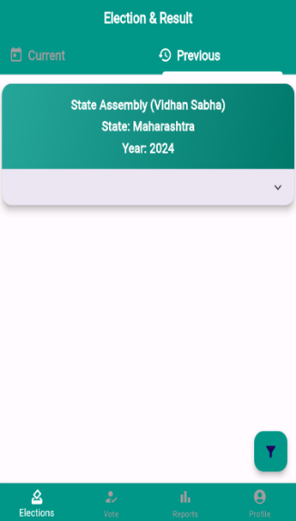
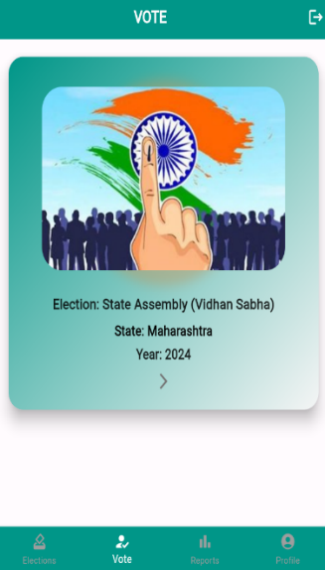
USER INTERFACE
D:\Project\Init Snap

Slide 23
HARDWARE USED
Mobile Devices:
Smartphone (iOS and Android)
Tablets (iOS and Android)
Servers:
Blockchain nodes (Sepholia TestNet)
Firebase
Development and Testing Hardware:
Laptops/Desktop for developers
Test devices (various models of smartphones and tablets)

Slide 24
SOFTWARE USED
1. Blockchain Network:
- Ethereum (Sepholia)
2. Smart Contract (Development):
- Solidity
3. Mobile App Development Frameworks:
- Android
- Flutter
4. Database:
- Firebase
5. Development and Testing Tools:
- Android Studio
- Remix IDE
6. API Integration:
- Web3dart (package)
- QuickNode

Slide 25
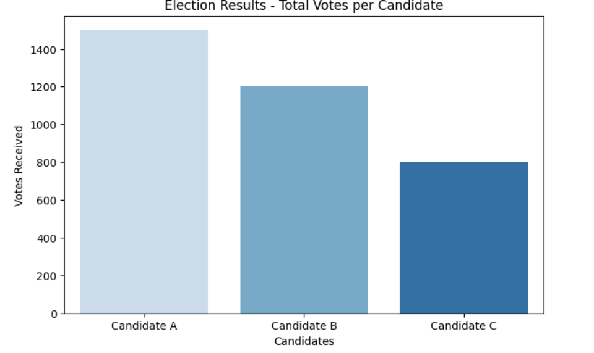
EXPECTED RESULT
BAR GRAPH

Slide 26
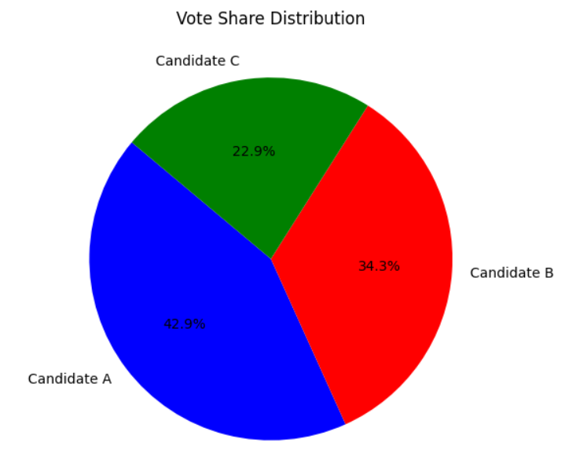
EXPECTED RESULT
PIE CHART

Slide 27
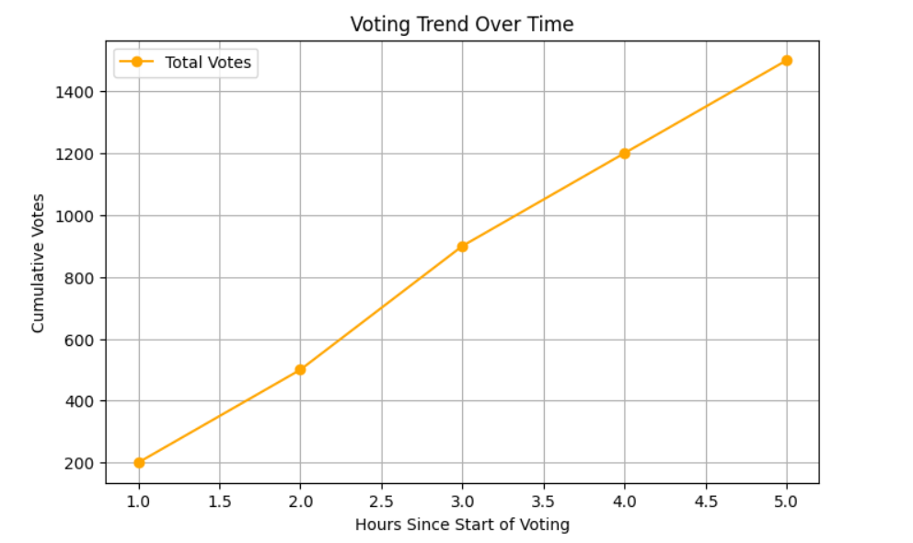
EXPECTED RESULT
LINE GRAPH

Slide 28
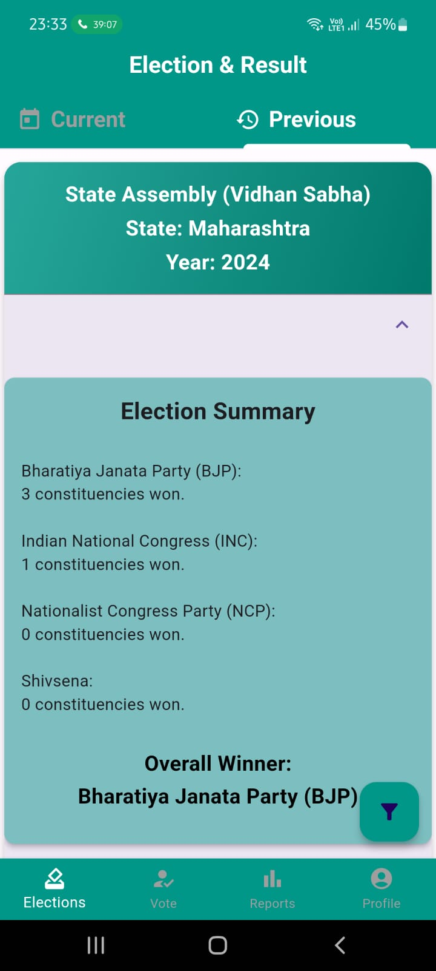
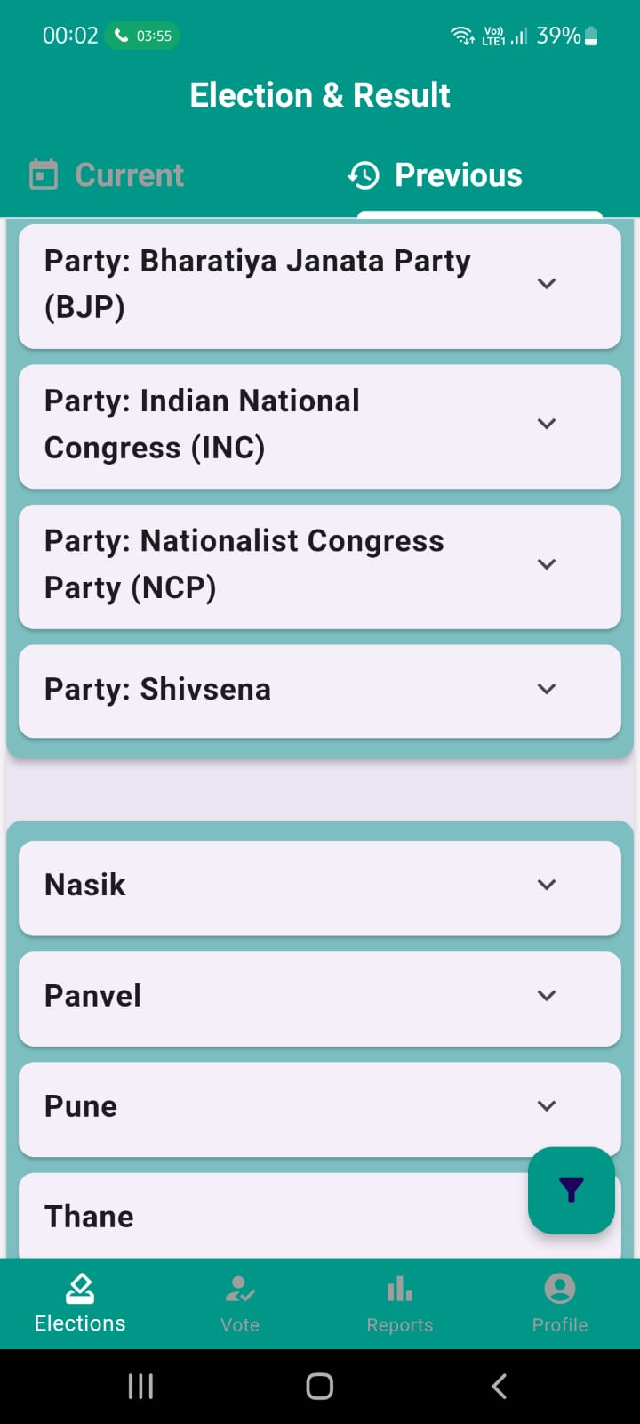
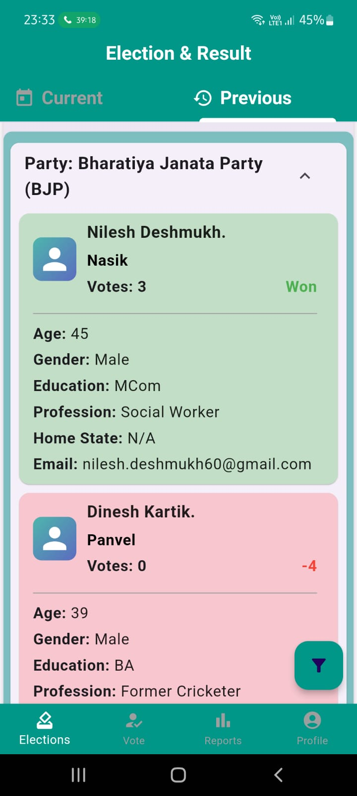
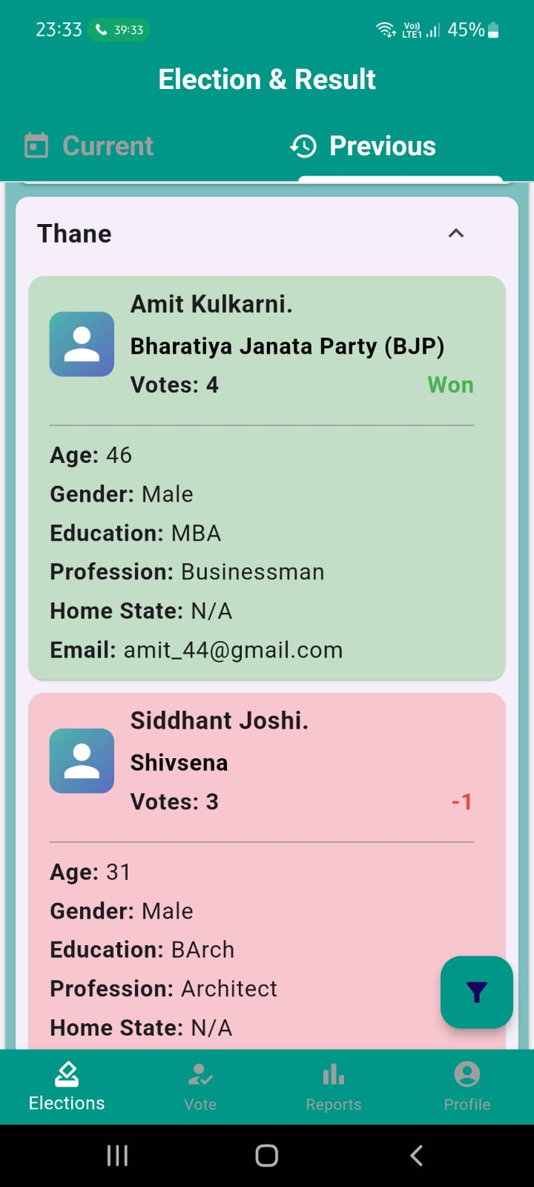
RESULT

Slide 29
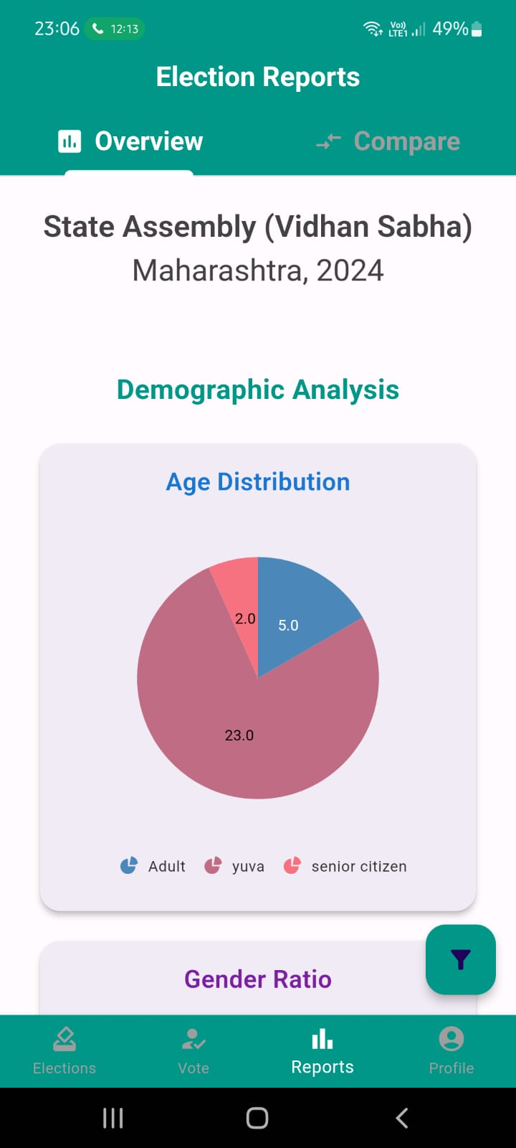
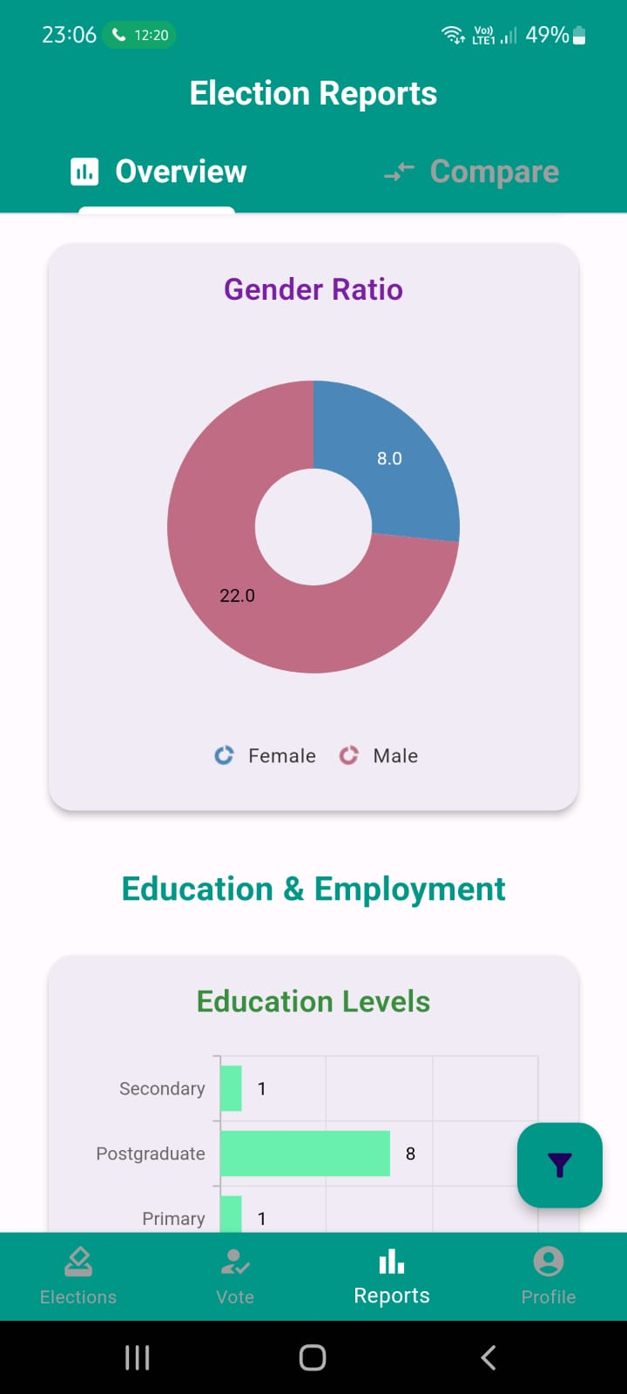
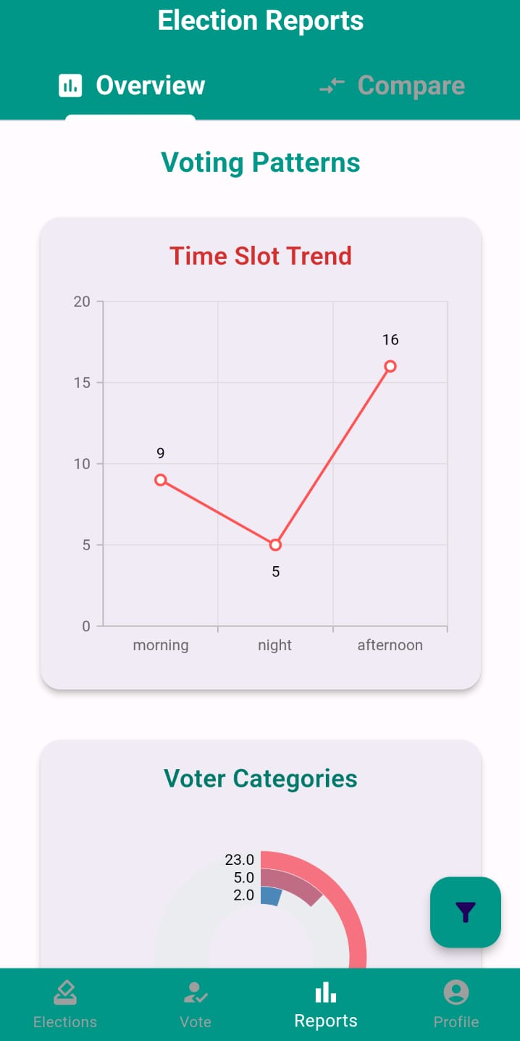
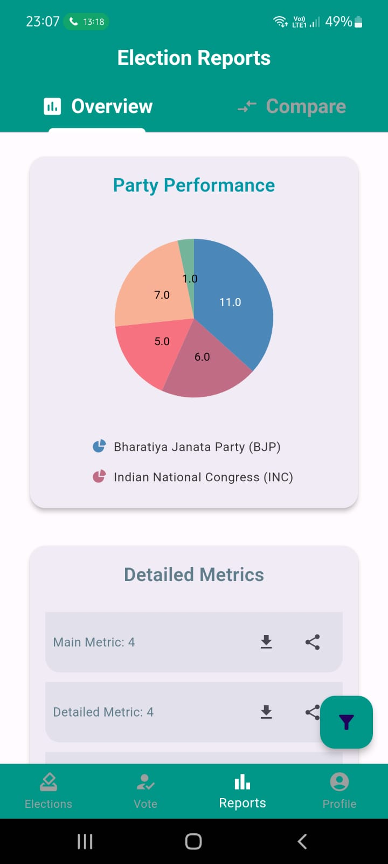
RESULT

Slide 30
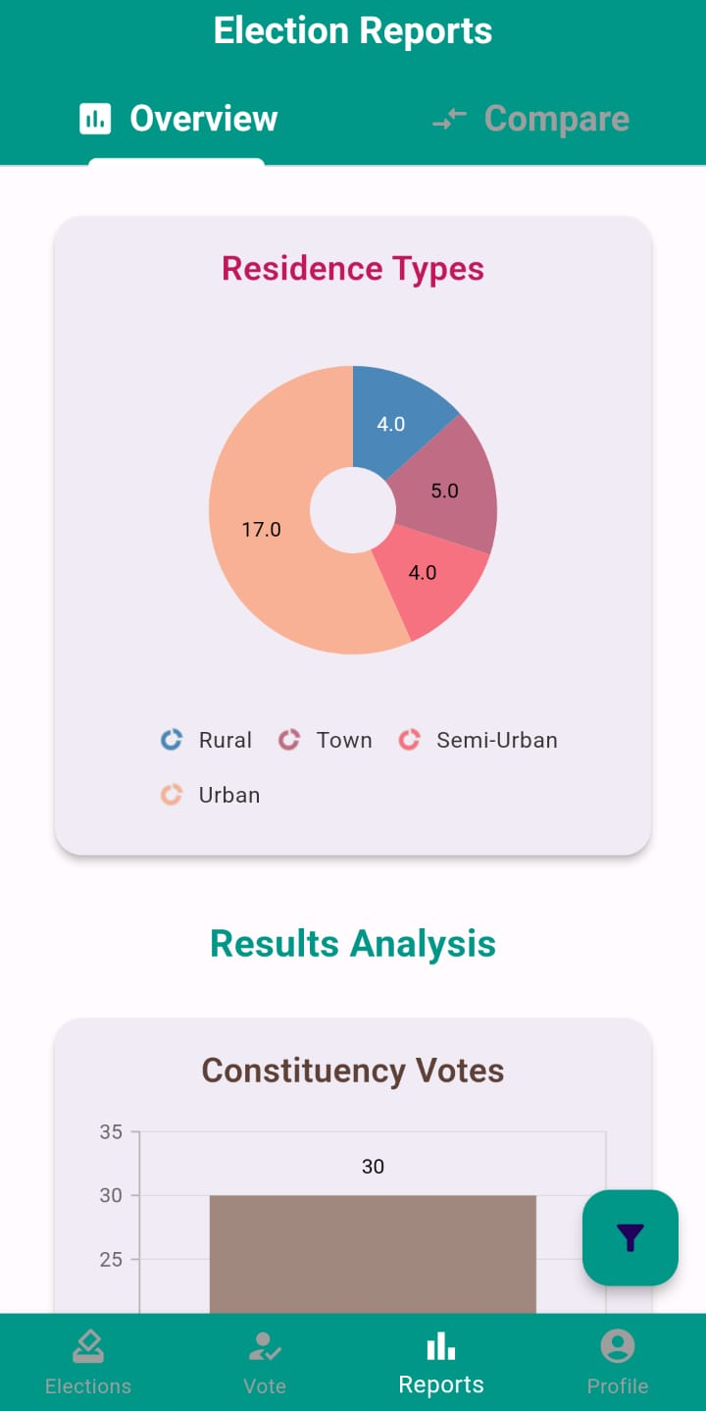
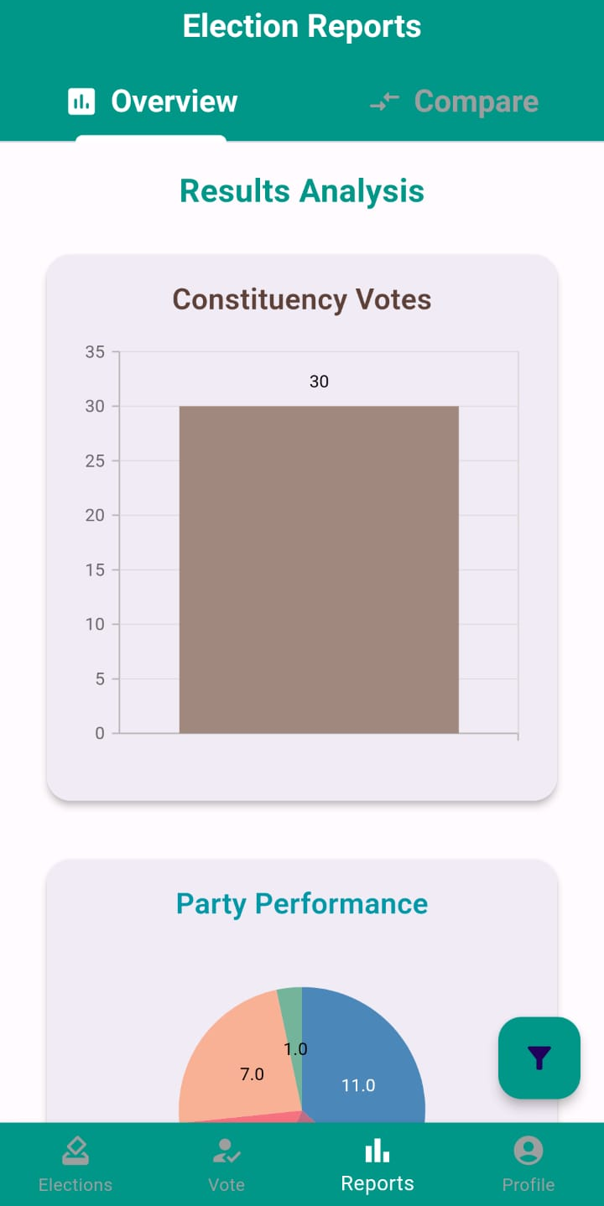
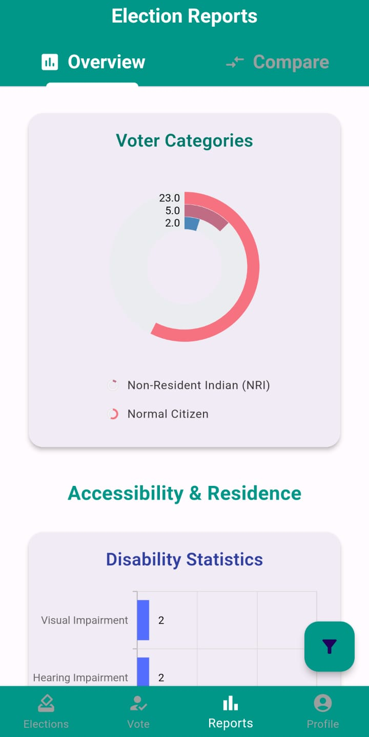
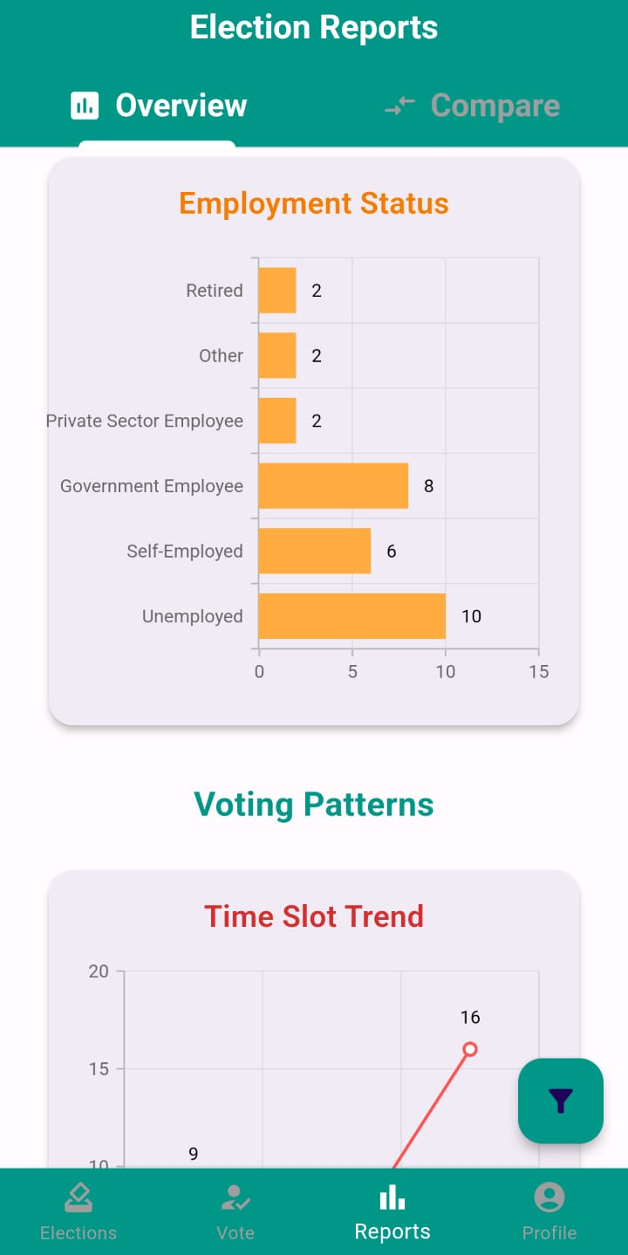
RESULT

Slide 31
EXPECTED OUTCOMES
We expect that the system will allow voters to securely cast their votes via a mobile application, with immutable vote records on the blockchain to prevent tampering, ensuring a transparent election process through a public ledger accessible to all, while protecting voter identity. Additionally, real-time results will be directly calculated from the system, with scalability to handle large-scale elections, and auditability will provide election officials with access to logs to maintain election integrity.

Slide 32
CONCLUSION
The Blockchain-Based Online Voting System provides a secure, scalable, and transparent platform for conducting elections.
By leveraging blockchain, the system ensures tamper-proof voting, real-time result aggregation, and verifiability.
The integration of multi-factor authentication, encryption, and a secondary database optimizes performance and security for large-scale elections.
This project represents a significant step towards modernizing the electoral process, minimizing costs, and ensuring voter trust in the system.

Slide 33
REFERENCE
Research Papers and Articles:
1.Akhil Shah, Nishita Sodhia, Shruti Saha, Soumi Banerjee, Madhuri Chavan (2020). "Blockchain Enabled Online-Voting System" ITM Web of Conferences, 32, 03018.
2.Stephan Neumann, Oksana Kulyk, Melanie Volkamer (2014). "A Usable Android Application Implementing Distributed Cryptography for Election Authorities" Journal of Cryptography, 7(2), 120-130.
3.G. Kalaiyarasi, T. Narmadha, K. Balaji, V. Naveen (2020). "E-Voting System in Smart Phone Using Mobile Application" International Journal of Advanced Research in Computer Science, 11(4), 41-48.
4.Jae-Geun Song, Sung-Jun Moon, Ju-Wook Jang (2021). "A Scalable Implementation of Anonymous Voting over Ethereum Blockchain" IEEE Access, 9, 37930-37942.

Slide 34
REFERENCE
Research Papers and Articles:
5.Hussam Saeed Musa, Moez Krichen, Adem Alpaslan Altun, Meryem Ammi (2019). "Survey on Blockchain-Based Data Storage Security for Android Mobile Applications" Journal of Blockchain Research, 5(3), 102-110.-
6.Dr. Aree Ali Mohammed, Ramyar Abdolrahman Timour (2020). "Efficient E-voting Android Based System" International Journal of Advanced Computer Science and Applications, 11(5), 75-81.

Slide 35
THANK YOU !!

